Slide 1


Customer Churn Prediction
By Group One

Slide 2
Project Overview
Phase I
Introduction of Data set and Data Summary
Phase II
Data Analysis and Visualization
Phase III
Data Insights and Recommendation

Slide 3

Phase I
Introduction of Data set and Data Summary

Slide 4
Introduction
This data set contains customer level information for a telecom company. Various attributes related to the services used are recorded for each customer.
Features | Description | Data Type
Churn | 1 if customer cancelled service, 0 if not | Integer
AccountWeeks | Number of weeks customer has had active account | Integer
ContractRenewal | 1 if customer recently renewed contract, 0 if not | Integer
DataPlan | 1 if customer has data plan, 0 if not | Integer
DataUsage | Gigabytes of monthly data usage | Number
CustServCalls | Number of calls into customer service | Integer
DayMins | Average daytime minutes per month | Number
DayCalls | Average number of daytime calls | Integer
MonthlyCharge | Average monthly bill | Number
OverageFee | Largest overage fee in last 12 months | Number
RoamingMins | Roaming calls by customer | Number
DataUsagecat | Categorization of data users based on data consumed | Character

Slide 5
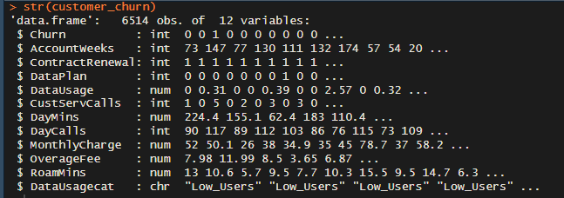
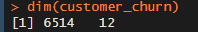
No of Variables and Rows
The data set has 12 columns and 6,514 rows
str package gives insights on the data structure.
dim package displays the number of columns and rows in the data set

Slide 6
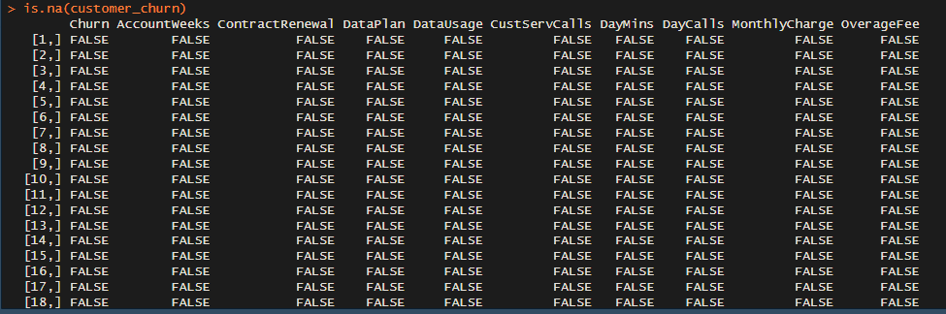
Check Data Set for NA/Missing Values
is.na package spots NA or missing values. The output shows no NA or missing values from our data set.

Slide 7
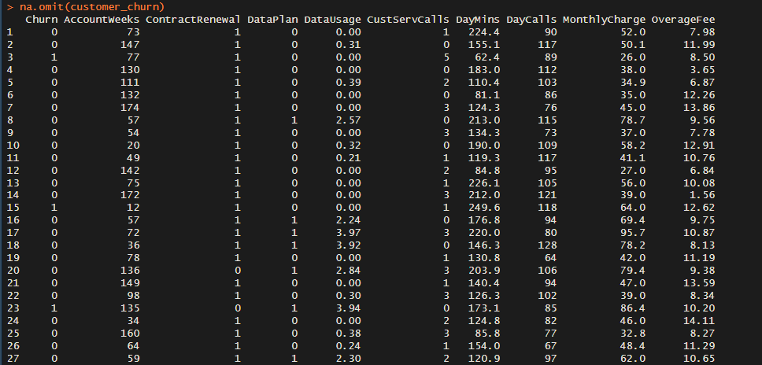
Omit NA/Missing Values from the Data Set
na.omit package omits NA or missing values. The output shows NA or missing values has been omitted from the data set.

Slide 8
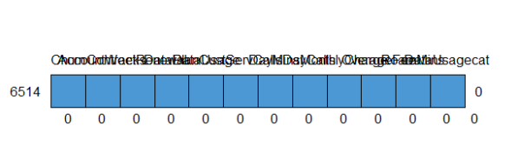
Check for any NA/Missing Value Pattern
mice package is applied to detect NA/missing values patterns in the data set. The output shows no NA or missing value pattern from our data set.

Slide 9
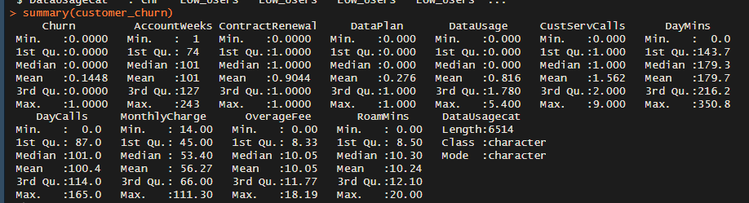
Summary of Our Data Set
The summary package is applied to summarize our data set highlighting valuable insight in our data.

Slide 10
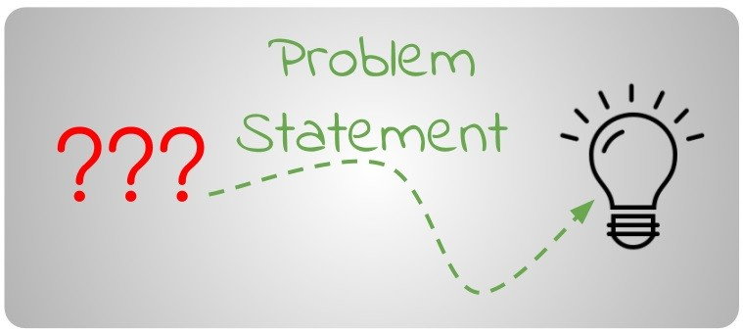
Problem Statement
Before we move on let’s try to define some problem we intend to solve

Slide 11

Some possible insights could be
What variables are contributing to customer to churn?
What actions can be taken to stop them from leaving?

Slide 12

Phase II
Data Analysis and Visualization

Slide 13
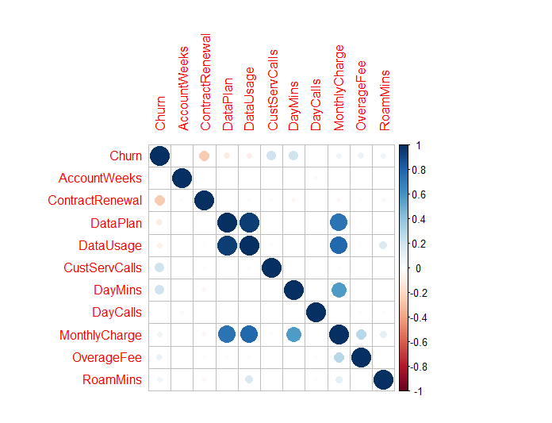
Correlation Plot
The corrplot package helps visualize the correlation between the numeric features .

Slide 14
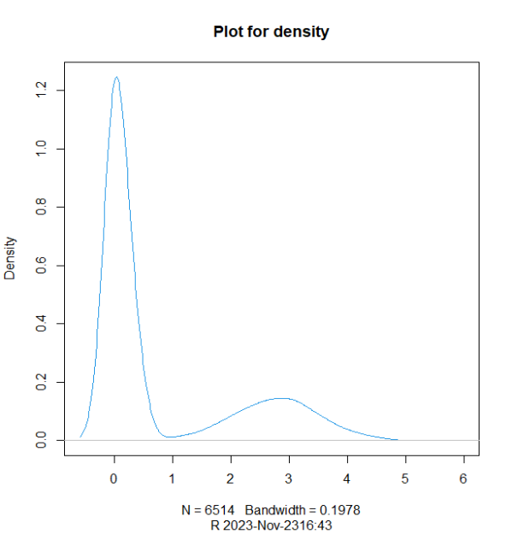
Density Plot
The density package was used to generate the output. The output shows a high frequency of customers below 1GB in data usage

Slide 15
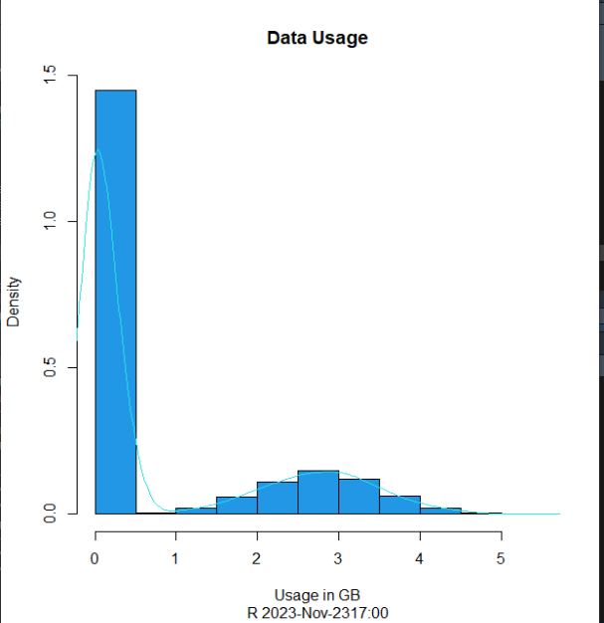
Density and Histogram Plot
The hist and density package was used to generate the output. The output shows a normal distribution for Data usage

Slide 16
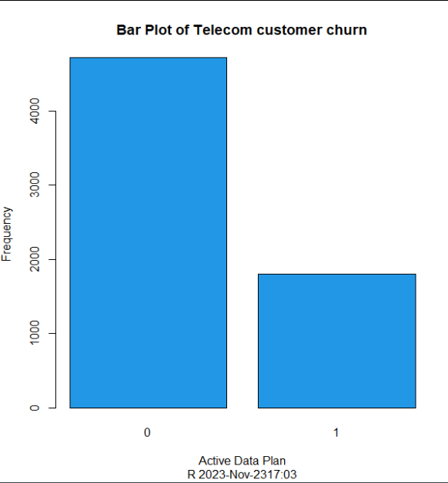
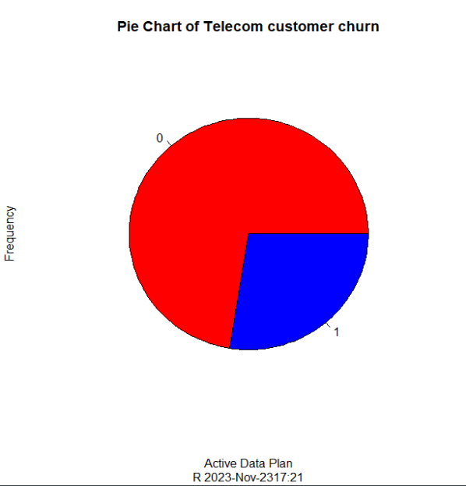
Bar Plot and Pie Chart
1 means customer with active plan 0 means customer without a data plan. The output shows large portion of customers are at the risk of churning out of the network.

Slide 17
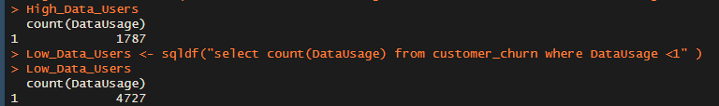
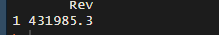
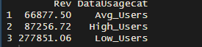
Data Management Analysis
The sqldf package is applied to group the revenue by category.
The output shows Low data users generate 64.2% , while high data users generate 20.1% and average data users generate 15.5% of the revenue category.
The sqldf package is applied to extract count of customer the a high and low data users .
The sqldf package is applied to calculate total revenue generated by customers.

Slide 18

Phase III
Data Insights and Recommendation

Slide 19

Now let’s try to answer some of our problem statement

Slide 20
Problem Statement 1
What variables are contributing to customer churn?
Contract Renewal :
The data also shows there is a weak correlation between Contract Renewal and churn, which indicates that customers who do not renew their contract are likely to churn out of the network
Data Usage :
The data shows 72.6% are low data users while 27.4% are high data users, meaning a high number customers are at the brink of churning out of the network

Slide 21
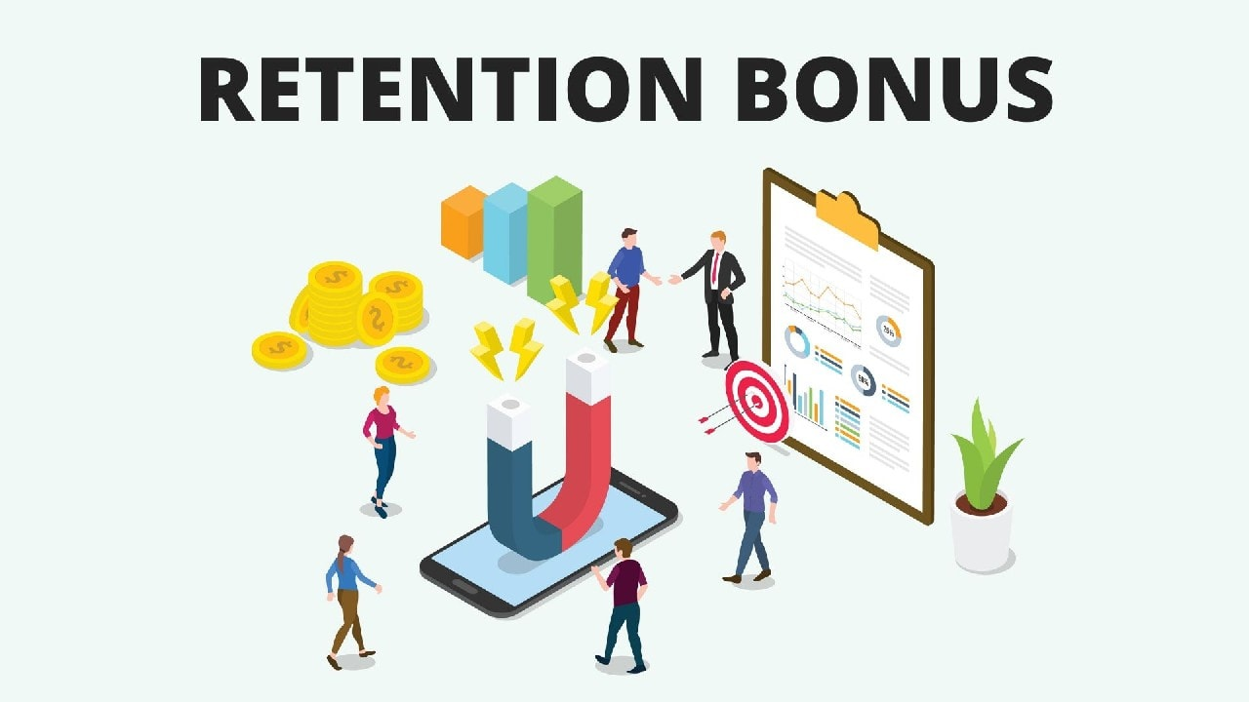
Problem Statement 2
What actions can be taken to stop them from leaving?
Retention Offers: Identify high-risk customers and provide targeted retention offers, such as discounts or additional services, to encourage them to stay.

Slide 22

Problem Statement 2 cont’d
What actions can be taken to stop them from leaving?
Bundling Services: Offer bundles of telecom services (e.g., TV, internet, and mobile) to incentivize customers to stay with your company.

Slide 23

Problem Statement 2 cont’d
What actions can be taken to stop them from leaving?
Quality Network and Service: Ensure the quality and reliability of your network and services. Invest in infrastructure to reduce dropped calls, slow data speeds, and service interruptions.

Slide 24

Problem Statement 2 cont’d
What actions can be taken to stop them from leaving?
Competitive Analysis: Stay up-to-date with the offerings and pricing of your competitors. Ensure that your plans and services remain competitive.

Slide 25
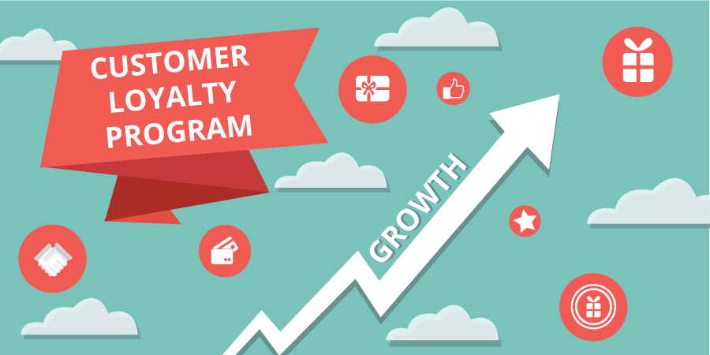
Problem Statement 2 cont’d
What actions can be taken to stop them from leaving?
Loyalty Programs: Develop customer loyalty programs that reward long-term customers with exclusive benefits and discounts.

Slide 26
THE END

